Slide 1
Information Visualization by
Dr. Parvathi.R
VIT University, Chennai

Slide 2
Syllabus
Introduction to Data Visualization : Overview of data visualization - Data Abstraction - Task Abstraction - Analysis: Four Levels for Validation, Human Visual Perception
Visualization Techniques – I : Scalar and point techniques – vector visualization techniques – matrix visualization
Visualization Techniques – II : Visualization Techniques for Trees, Graphs, and Networks, Multidimensional data
Visual Analysis of data from various domains - I : Time-oriented data visualization – Spatial data visualization and case studies
Visual Analysis of data from various domains – II : Text data visualization – Multivariate data visualization, and case studies
Designing Effective Visualizations : Guidelines for designing successful visualizations, Data visualization dos and don’ts
Dashboard Creation and Visual Story Telling :Dashboard Design principles, Effective Dashboard Display Media, Dashboard creation using visualization tools for the use cases: Finance marketing-insurance-healthcare etc.,

Slide 3
List of experiments
Association Rule Mining and Clustering using R
2. Visualization on KNN or Naive Bayes Classification using R
3. Financial analysis using Clustering, Histogram and HeatMap
4. Time-series analysis – stock market
5. Visualization of various massive dataset - Finance - Healthcare - Census - Geospatial
6. Visualization on Streaming dataset (Stock market dataset, weather forecasting)
7. Market-Basket Data analysis-visualization
Text visualization using web analytics
R/python/ and R integration in Tableau
Google API with maps
15. Dash Board Creation using Tableau

Slide 4
Project
Analysis of social media data using visualization (Sentiment Analysis, Opinion Mining, Recommender Systems)
Visualization of Fraudulent Behavior in finance and insurance sectors
Creating dashboard using visualization to enable quick decision making on IOT (data will be received from different sensors & stored in data centers. It will help us to identify & take quick decision according to the real time and historic data trends and alarms displayed in the dashboard)

Slide 5
Text/Reference Book
Text Books
1. Tamara Munzer, Visualization Analysis and Design -, CRC Press 2014
2. Stephen Few, “Information Dashboard Design: the effective visual communication of data”, Oreilly, 2006.
3. Matthew O. Ward, Georges Grinstein, Daniel Keim "Interactive Data Visualization: Foundations, Techniques, and Applications", CRC Press, Second Edition, 2015.
4. Dr.Chun-hauh Chen, W.K.Hardle, A. Unwin, “Handbook of Data Visualization”, Springer publication, 2008.
5. Ben Fry, “Visualizing Data”, O'Reilly Media, 2008 7. Winston Chang, "R Graphics Cookbook", O'Reilly, 2012.

Slide 6
Visualization
Computer-based visualization systems provide visual representations of datasets designed to help people carry out tasks more effectively.
Vis systems are appropriate for use when your goal is to augment human capabilities, rather than completely replace the human in the loop.

Slide 7
Why Have a Human in the Loop?
Vis allows people to analyze data when they don’t know exactly what questions they need to ask in advance.
Example : Descriptive analysis (clustering)

Slide 8
Why Have a Computer in the Loop?
By enlisting computation, you can build tools that allow people to explore or present large datasets that would be completely infeasible to draw by hand, thus opening up the possibility of seeing how datasets change over time.

Slide 9
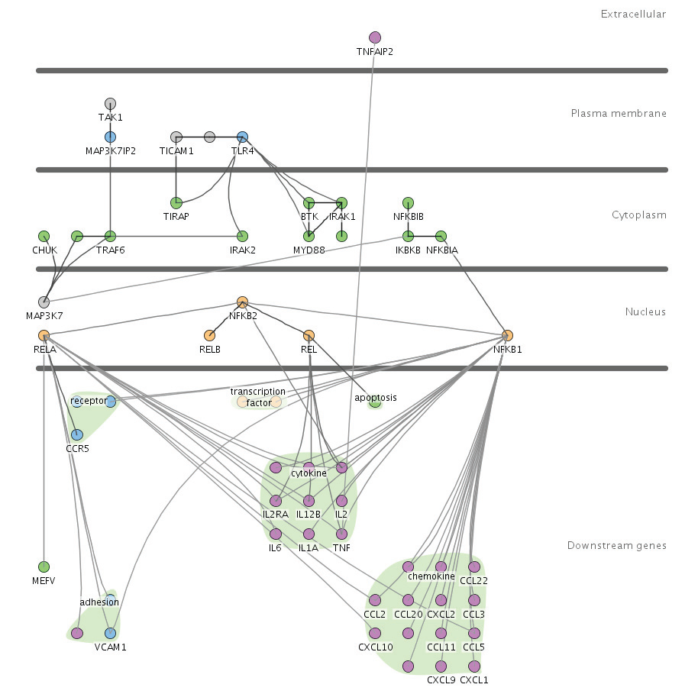
A small network of 57 nodes
and 74 edges

Slide 10
Why Show the Data in Detail?
Vis tools help people in situations where seeing the dataset structure in detail is better than seeing only a brief summary of it. One of these situations occurs when exploring the data to find patterns, both to confirm expected ones and find unexpected ones.

Slide 11
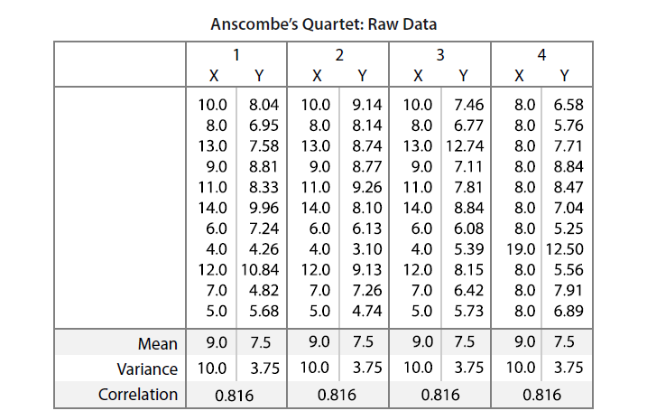
Anscombe’s Quartet, a suite of four small datasets designed by a statistician to illustrate
how datasets that have identical descriptive statistics can have very different structures that are immediately obvious when the dataset is shown graphically. All four have identical
mean, variance, correlation, and linear regression lines.

Slide 12
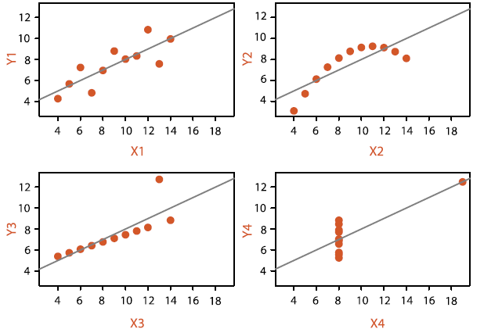
First dataset probably isn’t surprising, and matches your intuition
The second scatter plot shows a clear nonlinear pattern in the data
The third dataset shows how a single outlier can lead to a regression line
regression line that’s almost perpendicular to the true pattern

Slide 13
Why Use Interactivity?
Interactivity is crucial for building vis tools that handle complexity. When datasets are large enough, the limitations of both people and displays preclude just showing everything at once;
interaction where user actions cause the view to change is the way forward.
Moreover, a single static view can show only one aspect of a dataset.
Ex: Region wise (East,West,South,North) sales

Slide 14
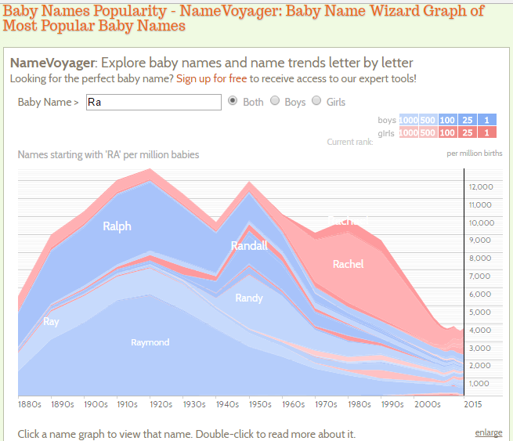
http://www.babynamewizard.com/voyager#prefix=ra&sw=both&exact=false

Slide 15
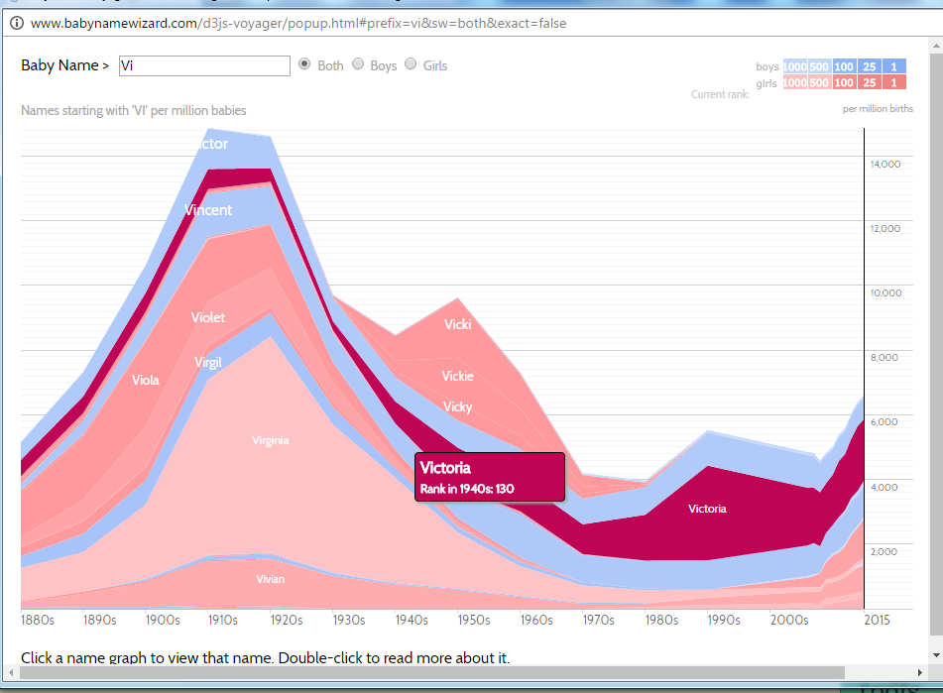

Slide 16
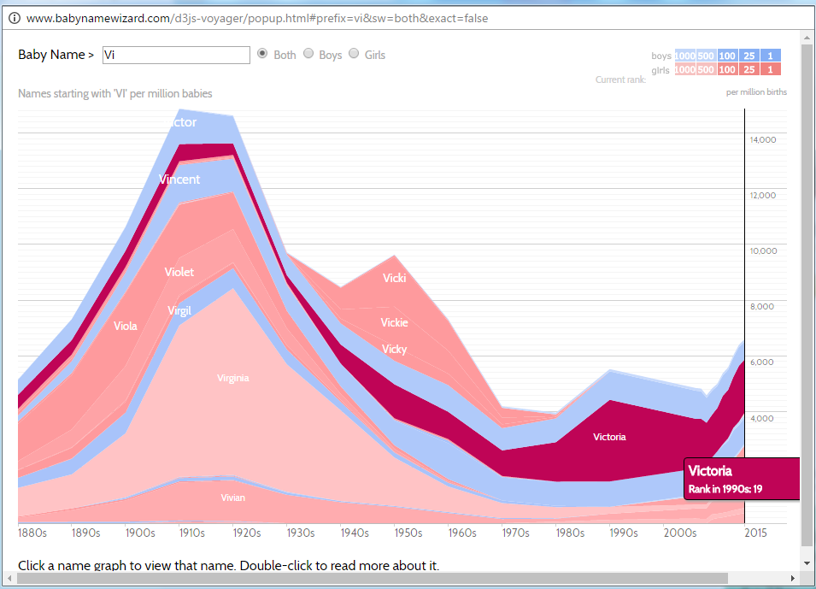

Slide 17
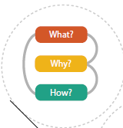
What? Why? How?
What data the user sees,
why the user intends to use a vis tool,
and how the visual encoding and interaction idioms(approach to create and manipulation visual representation- chart, graph etc) are constructed in terms of design choices

Slide 18
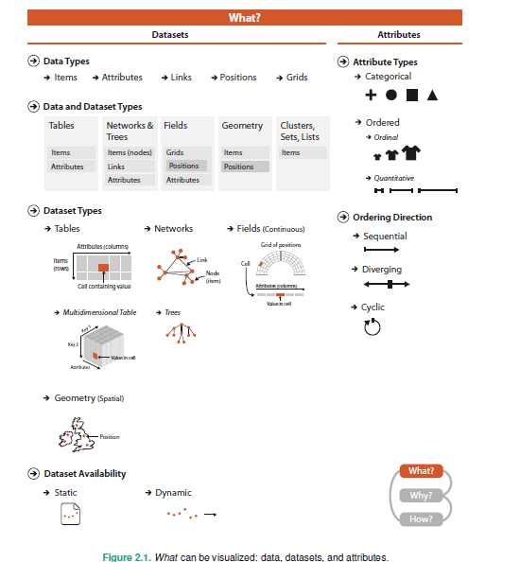

Slide 19
Figure shows the abstract types of what can be visualized. The four basic dataset types are tables, networks, fields, and geometry; other possible collections of items include clusters, sets, and lists. These datasets are made up of different combinations of the five data types: items, attributes, links, position, Grids
For any of these dataset types, the full dataset could be available immediately in the form of a static file, or it might be dynamic data processed gradually in the form of a stream. The type of an attribute can be categorical or ordered, with a further split into ordinal and quantitative.

Slide 20

Data Types
An attribute is some specific property that can be measured, observed, or logged. For Synonyms for attribute are variable and data dimension, or just dimension for short.
For example, attributes could be salary, price, number of sales, temperature.
An item is an individual entity that is discrete, such as a row in a simple table or a node a network.
For example, items may be people, stocks, coffee shops, genes, or cities.
A link is a relationship between items, typically within a network.

Slide 21
A grid specifies the strategy for sampling continuous data in terms of both geometric and topological relationships between its cells.
A position is spatial data, providing a location in two-dimensional (2D) or three-dimensional (3D) space.

Slide 22
Dataset Types
A dataset is any collection of information that is the target of analysis.
The four basic dataset types are tables, networks, fields, and geometry.
Other ways to group items together include clusters, sets, and lists.
In real-world situations, complex combinations of these basic types are common.

Slide 23
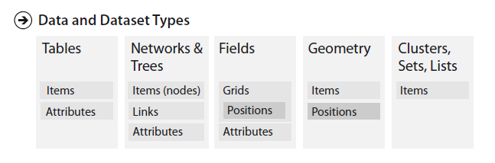

Slide 24
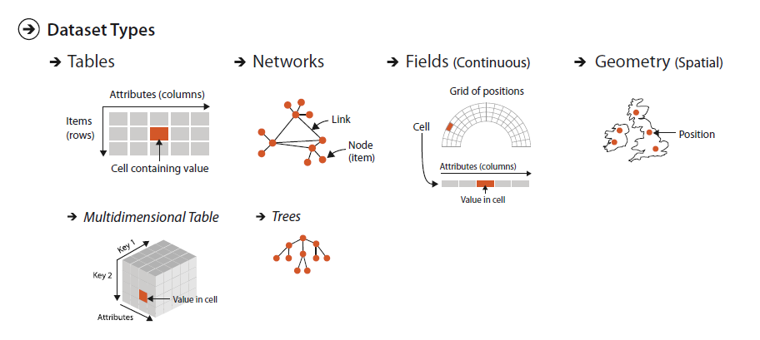

Slide 25
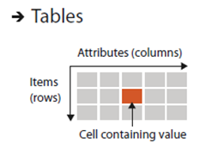
Many datasets come in the form of tables that are made up of rows and columns.
For a simple flat table:
each row represents an item of data
each column is an attribute of the dataset
Each cell in the table is fully specified by the combination of a row and a column—an item and an attribute—and contains a value for that pair.

Slide 26
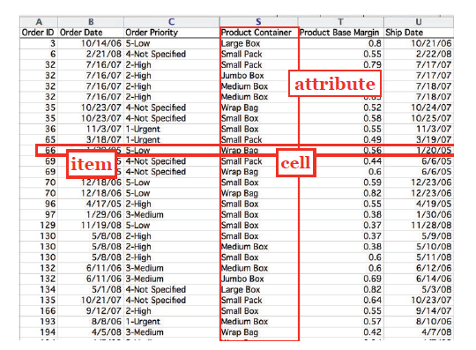

Slide 27
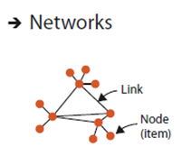
The dataset type of networks is well suited for specifying that there is some kind of relationship between two or more items.
An item in a network is often called a node. A link is a relation between two items.
Example : In a social network the nodes are people, and links mean friendship

Slide 28
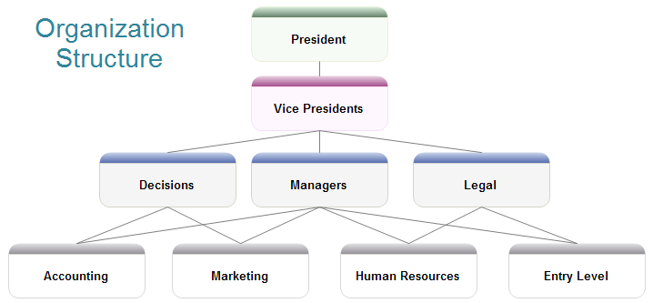
Networks with hierarchical structure are more specifically called trees. In contrast to a general network, trees do not have cycles
Example: organization chart of a company

Slide 29
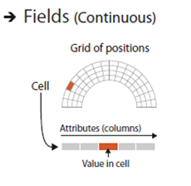
The field dataset type also contains attribute values associated with cells.
Each cell in a field contains measurements or calculations from a continuous domain
Ex: temperature, pressure, speed, force, and density

Slide 30
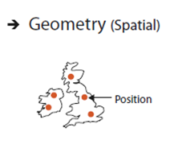
The geometry dataset type specifies information about the shape of items with explicit spatial positions. The items could be points, or one-dimensional lines or curves, or 2D surfaces or regions, or 3D volumes.

Slide 31
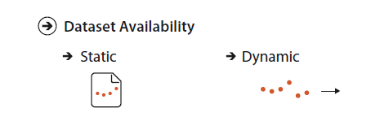

Slide 32
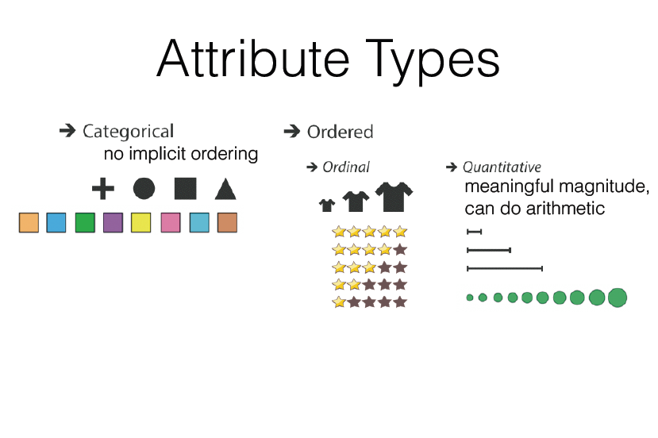

Slide 33
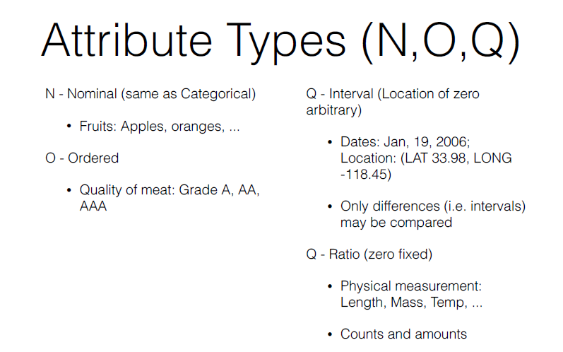

Slide 34
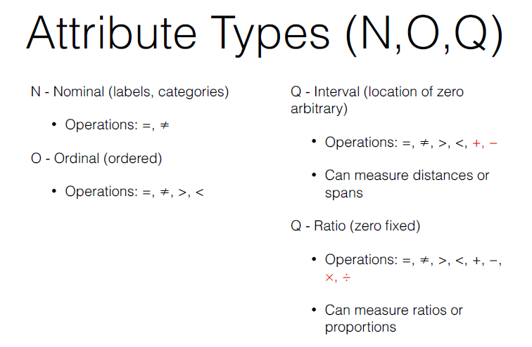

Slide 35
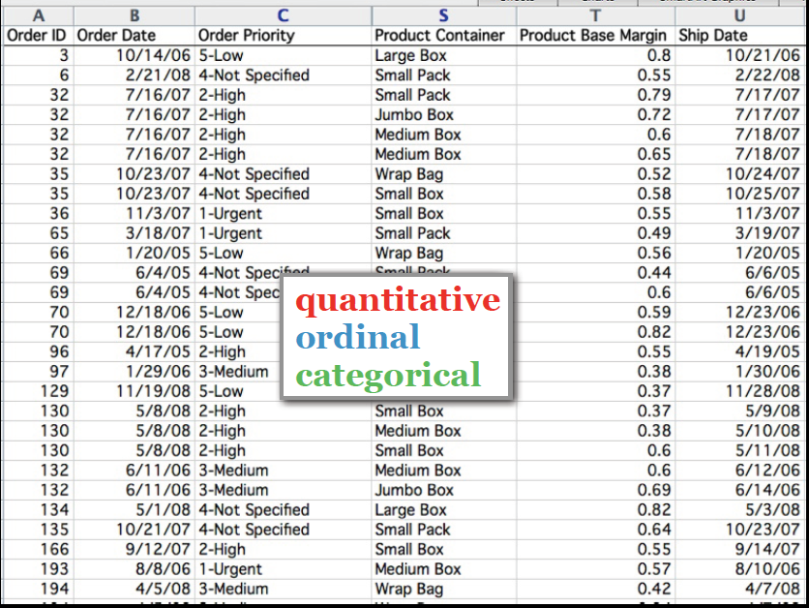

Slide 36
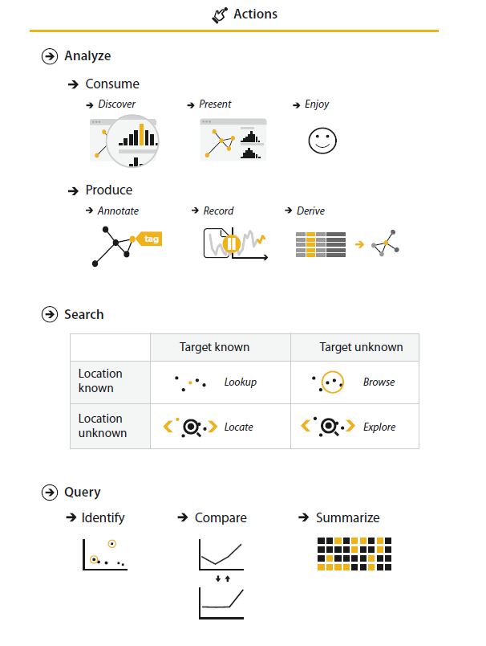
Why people are using vis in terms of actions and targets.
Why a vis tool is being used?
Three levels of actions that define user goals
The high-level choices describe how the vis is being used to analyze, either to consume existing data or to also produce additional data.
The mid-level choices cover what kind of search is involved, in terms of whether the target and location are known or not.
The low-level choices pertain to the kind of query: does the user need to identify one target, compare some targets, or summarize all of the targets?

Slide 37
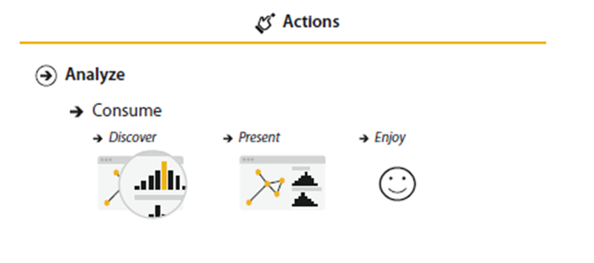
The most common use-case for vis is for the user to consume information that has already been generated as data stored in a format suitable to computation.
The framework has three further distinctions within that case:
for the user to discover something new or analyze information that is not already completely understood, or
whether the goal is to present something that the user already understands to a third party, or
for users to enjoy a vis to indulge their casual interests in a topic.

Slide 38
Discover:
The discover goal refers to using vis to find new knowledge that was not previously known.
Present :
The present goal refers to the use of vis for the brief communication of information, for telling a story with data, or guiding an audience through a series of cognitive operations.
One classic example of a present vis is static information graphics, such as a diagram in a newspaper or an image in a blog.
Enjoy :
The enjoy goal refers to casual encounters with vis.
Name Voyager, which was created for expectant parents deciding what to name their new baby. When the user types characters of a name.

Slide 39
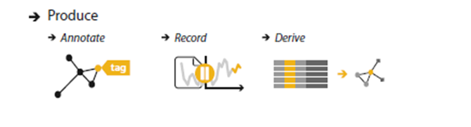
Produce
In contrast to using vis only for consuming existing information, in the produce case the goal of the user is to generate new material.
Often the goal with produce is to produce output that is used immediately, as input to a next instance.
There are three kinds of produce goals: annotate, record, and derive.
Annotate
The annotate goal refers to the addition of graphical or textual annotations associated with one or more preexisting visualization elements, typically as a manual action by the user.
For example, the user could annotate all of the points within a cluster with a text label.

Slide 40
Record
The record goal saves or captures visualization elements as persistent artifacts. These artifacts include screen shots, lists of book marked elements or locations, parameter settings.
Example of a record goal is to assemble a graphical history
Derive
The derive goal is to produce new data elements based on existing data elements. New attributes can be derived from information contained within existing ones, or data can be transformed from one type into another.
A dataset often needs to be transformed beyond its original state in order to create a visual encoding that can solve the desired problem. To do so, we can create derived attributes that extend the dataset beyond the original set of attributes that it contains.

Slide 41
In some cases, the derived attribute encodes the same data as transform. the original, but with a change of type. For example, a dataset might have an original attribute that is quantitative data: for instance, floating point numbers that represent temperature.
For some tasks, like finding anomalies in local weather patterns, that raw data might be used directly.
For another task, like deciding whether water is in appropriate temperature for a shower, that quantitative attribute might be transformed into a new derived attribute that is ordered: hot, warm, or cold. In this transformation, most of the detail is aggregated away.
In a third example, when making toast, an even more lossy transformation into a binary categorical attribute might be enough: burned or not burned.
In another example, creating the derived attribute requires access to additional information. For a geographic example, a categorical attribute of city name could be transformed into two derived quantitative attributes containing the latitude and longitude of the city.

Slide 42
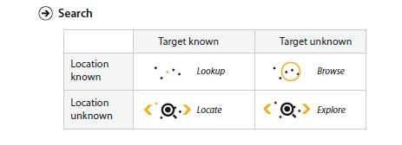

Slide 43
Search
All of the high-level analyze cases require the user to search for elements of interest within the vis
Lookup
If users already know both what they’re looking for and where it is, then the search type is simply lookup. as a mid-level goal.
Locate
To find a known target at an unknown location, the search type is locate: that is, find out where the specific object is.

Slide 44
Browse
In contrast, the exact identity of a search target might not be known in advance; rather, it might be specified based on characteristics. In this case, users are searching for one or more items that fit some kind of specification, such as matching up with a particular range of attribute values. When users don’t know exactly what they’re looking for, but they do have a location in mind of where to look for it, the search type is browse.
Explore
When users are not even sure of the location, the search type is explore.

Slide 45
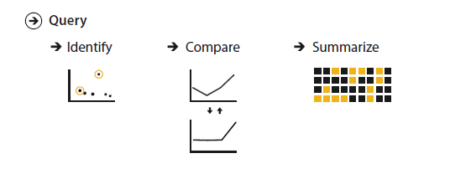
Query
Once a target or set of targets for a search has been found, a low level user goal is to query these targets at one of three scopes: identify, compare, or summarize.
Identify refers to a single target
Compare refers to multiple targets, and
Summarize refers to the full set of possible targets.

Slide 46
For a concrete example, consider different uses of a choropleth map of US election results, where each state is color-coded by the party that won.
A user can identify the election results for one state, compare the election results of one state to another, or summarize the election results across all states to determine how many favored one candidate or the other or to determine the overall distribution of margin of victory values.

Slide 47
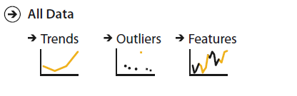
Four kinds of abstract targets
A trend is a high-level characterization of a pattern in the data. Simple examples of trends include increases, decreases, peaks, troughs, and plateaus.
some data doesn’t fit well with that backdrop; those elements are the outliers.
The exact definition of features is task dependent, meaning any particular structures of interest.

Slide 48
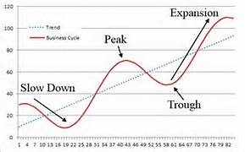
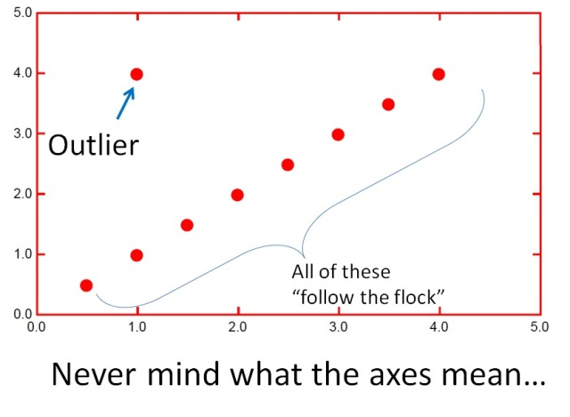
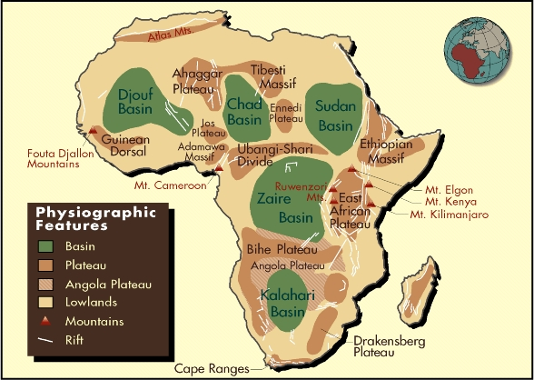

Slide 49
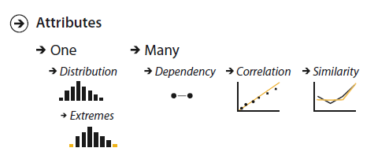
Attributes are specific properties that are visually encoded.
High-level scope is the distribution of all values for an attribute.
The lowest-level target for an attribute is to find an individual value.
A first attribute can have a dependency on a second, where the values for the first directly depend on those of the second.
There is a correlation between one attribute and another if there is a tendency for the values of second to be tied to those of the first.
The similarity between two attributes can be defined as a quantitative measurement calculated on all of their values, allowing attributes to be ranked with respect to how similar, or different, they are from each other.

Slide 50
Some targets pertain to specific types of datasets. Network data specifies relationships between nodes as links. The fundamental target with network data is to understand the structure of these interconnections; that is, the network’s topology.
A more specific topological target is a path of one or more links that connects two nodes.
For spatial data, understanding and comparing the geometric shape is the common target of user actions.

Slide 51
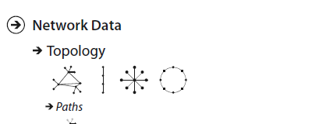

Slide 52
How ? Visual Encoding
Defining your goal
Examples of goals for visualizations
to monitor systems,
find bargains,
compare company performances,
select suitable solutions,
track populations,
tell stories,
find specific data points,
find outliers,
show trends,
or simply give an overview of the data.

Slide 53
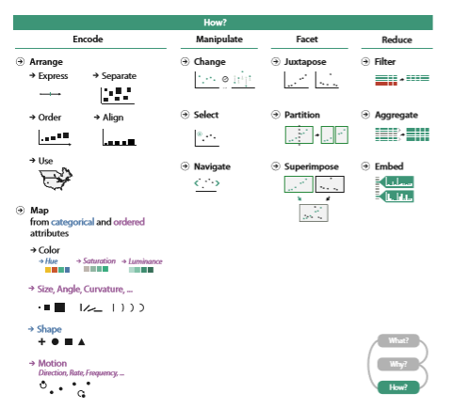

Slide 54
To begin defining the goal of your visualization, ask yourself
What values or data dimensions are relevant in this context?
Which of these dimensions matter; matter most; and matter least?
What are the key relationships that need to be communicated?
What properties or values would make some individual data points more interesting than the rest?

Slide 55
Show the sales figures / Show which product lines are performing best and worst in each region, for each of the last five quarters
Compare the demographics of Twitter and Facebook users / Compare the ages,education, and income levels of Twitter and Facebook users
Second statement indicate specific values and relationships that the visualization should make available to the reader.
first statement of each pair conveys a general intention, but no particular direction, and lends no specific guidance in determining what to include, how it should relate to anything else, or how to tell

Slide 56
Choose Appropriate Visual Encodings
Two key factors are whether a visual property is naturally ordered, and how many distinct values of this property the reader can easily differentiate
Natural Ordering
For example, position has a natural ordering; shape doesn’t.
Length has a natural ordering; texture doesn’t (but pattern density does).
Line thickness or weight has a natural ordering; ; line style (solid, dotted, dashed) doesn’t.
Distinct Values
The second main factor to consider when choosing a visual property is how many distinct values it has that your reader will be able to perceive, differentiate, and possibly remember.

Slide 57
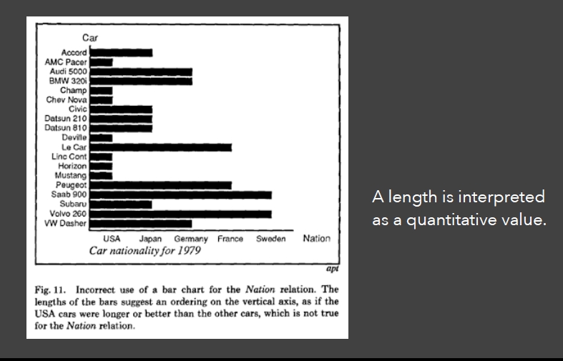

Slide 58
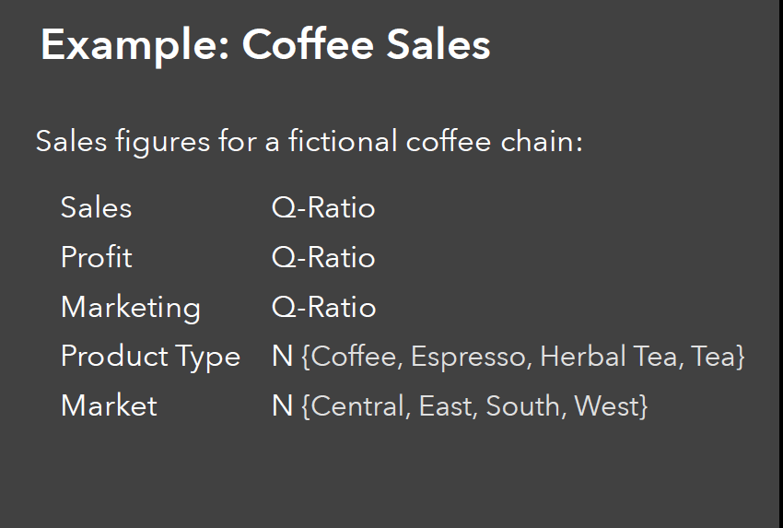

Slide 59
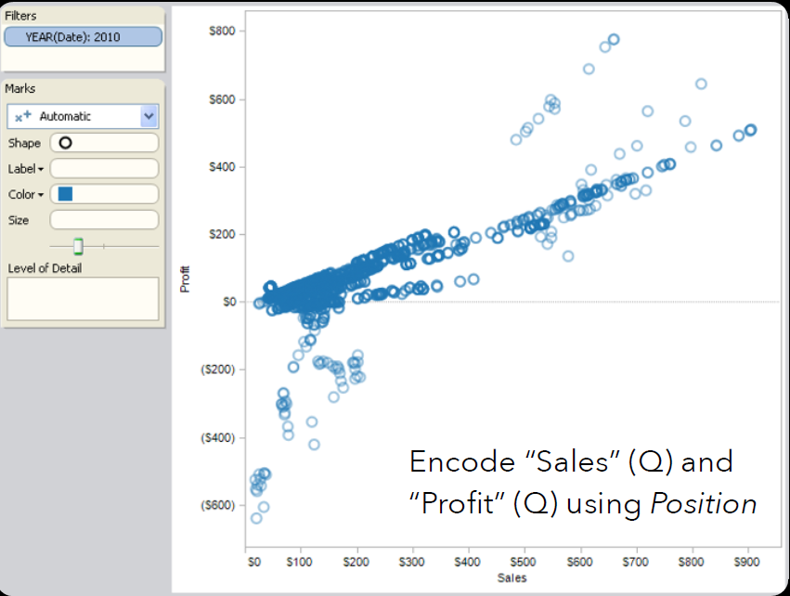

Slide 60
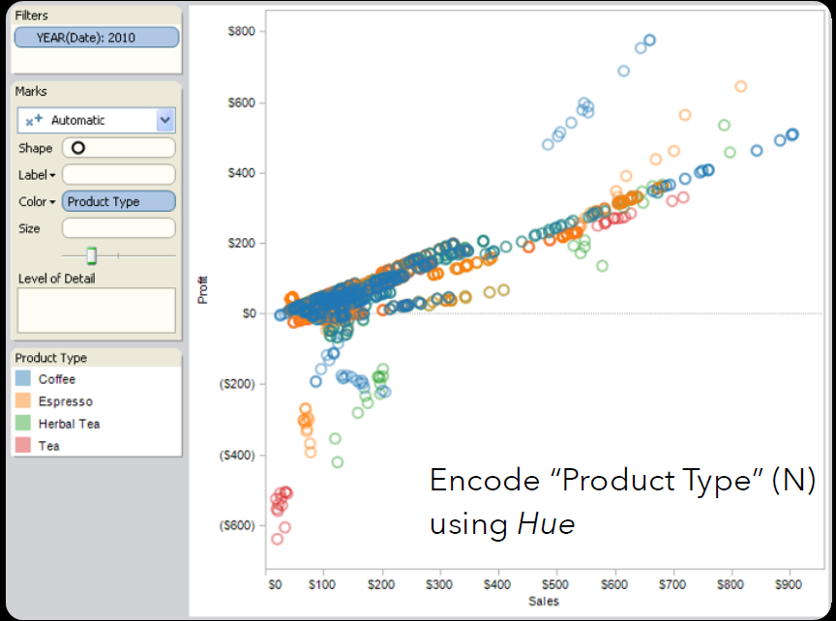

Slide 61
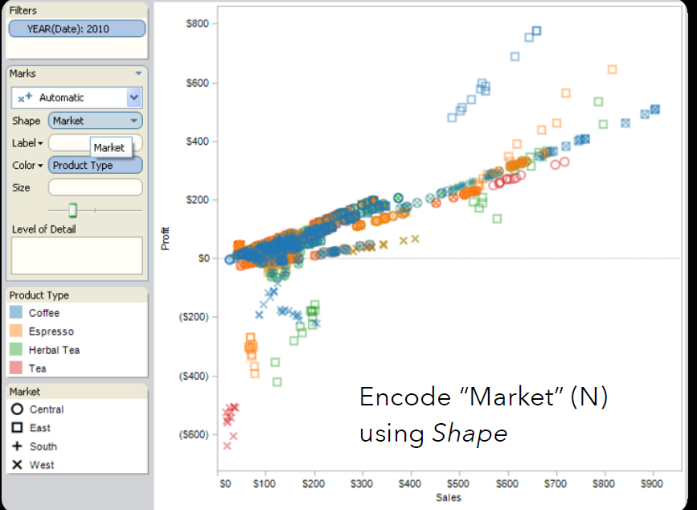

Slide 62
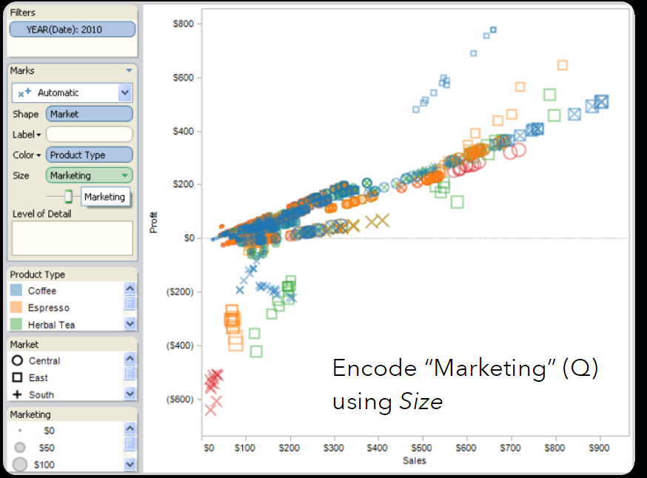

Slide 63


Slide 64
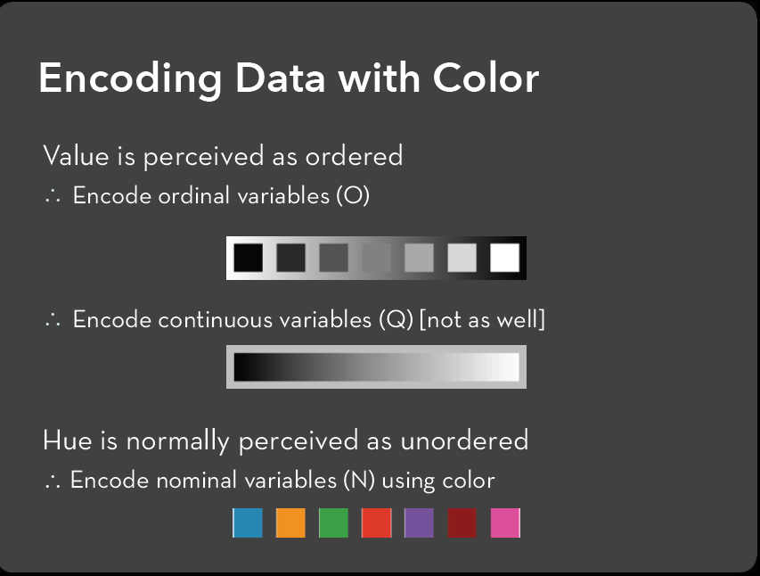

Slide 65


Slide 66
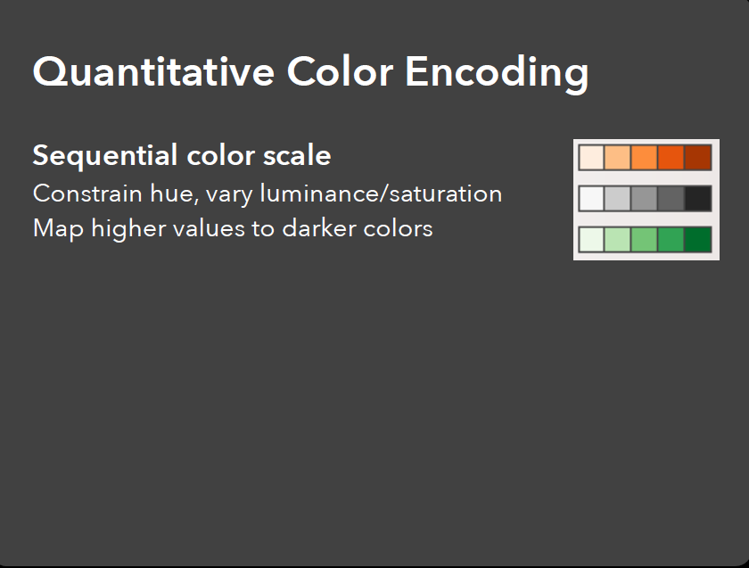

Slide 67
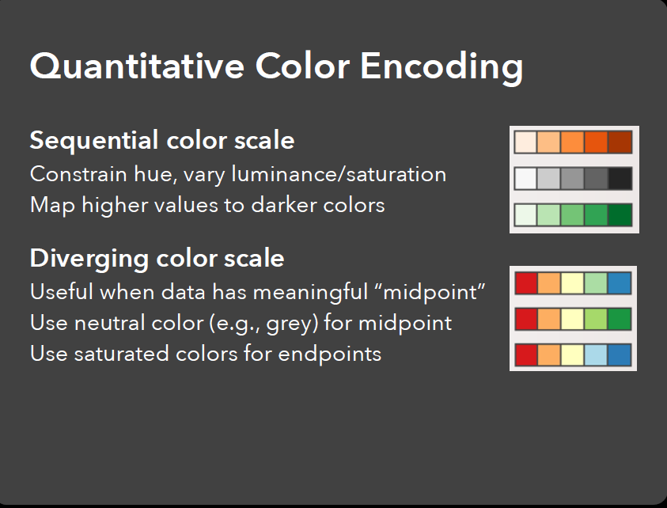

Slide 68
Four Levels of Design-
Validations

Slide 69
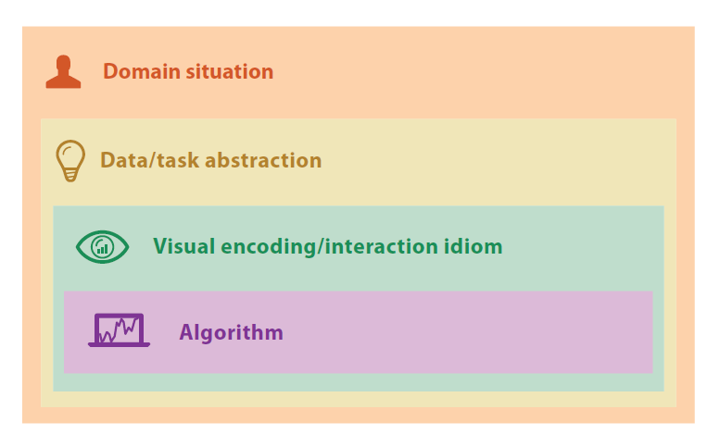
The four nested levels of vis design.

Slide 70
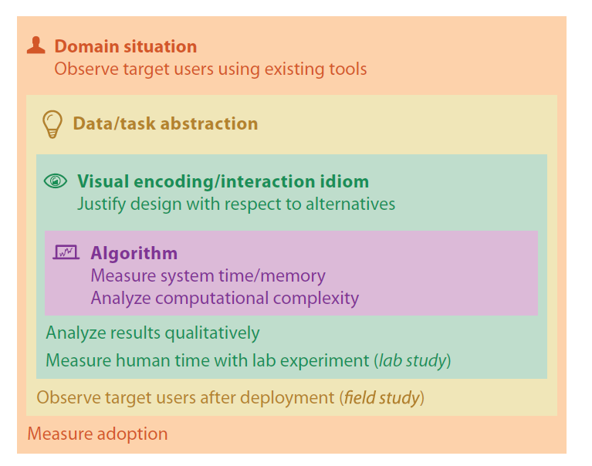

Slide 71
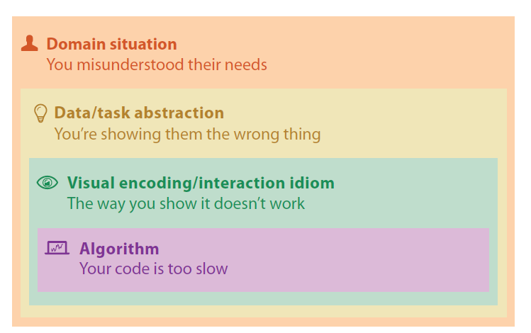
The four nested levels of vis design have different threats to validity at each level.

Slide 72
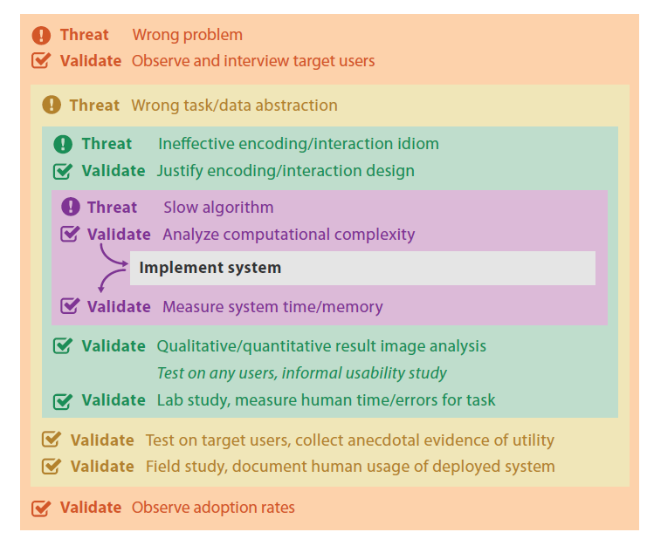
Validation Approaches

Slide 73
